Slide 1
Inferno Tech Talk – Jan 2024
Robert Scanlon
MITRE Inferno Team
January 10, 2024

Slide 2
Inferno Tech Talk Introduction
Purpose: to provide regularly scheduled updates on the Inferno tool and its implementation of the (g)(10) test procedure
Typical agenda to include:
Announcements about upcoming releases
Training on new features
Highlight outstanding issues or known problems
Open discussion
Monthly recurrence: 2nd Wednesday at 1PM ET
Content reflects Inferno’s implementation of applicable Test Procedure
and does not necessarily reflect ONC policy.

Slide 3
Today’s Agenda
(g)(10) Standardized API Test Kit v5.0.0
Preview of Site Redesigns:
Inferno on HealthIT.gov
Inferno Framework Home

Slide 4
ONC (g)(10) Standardized API Test Kit v5.0.0
Approved Standard Update:
Removal of US Core v5 / USCDI v2
Test Update:
Changes that may result in new failure: 1

Slide 5
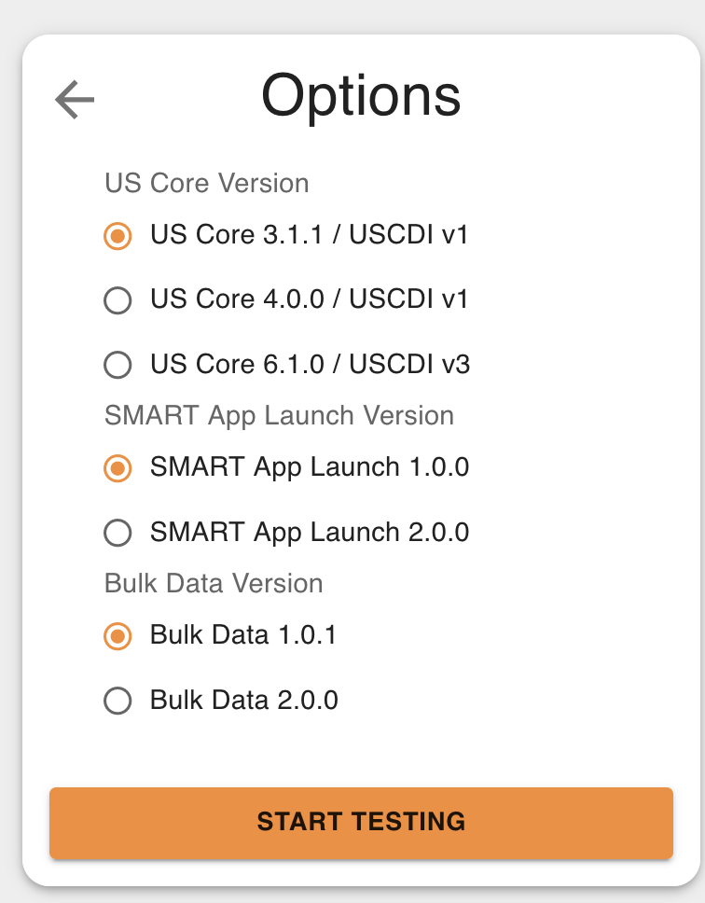
Approved Standards Update
Removes US Core v5 / USCDI v2
ONC requirement to remove this option for new certifications starting this month

Slide 6
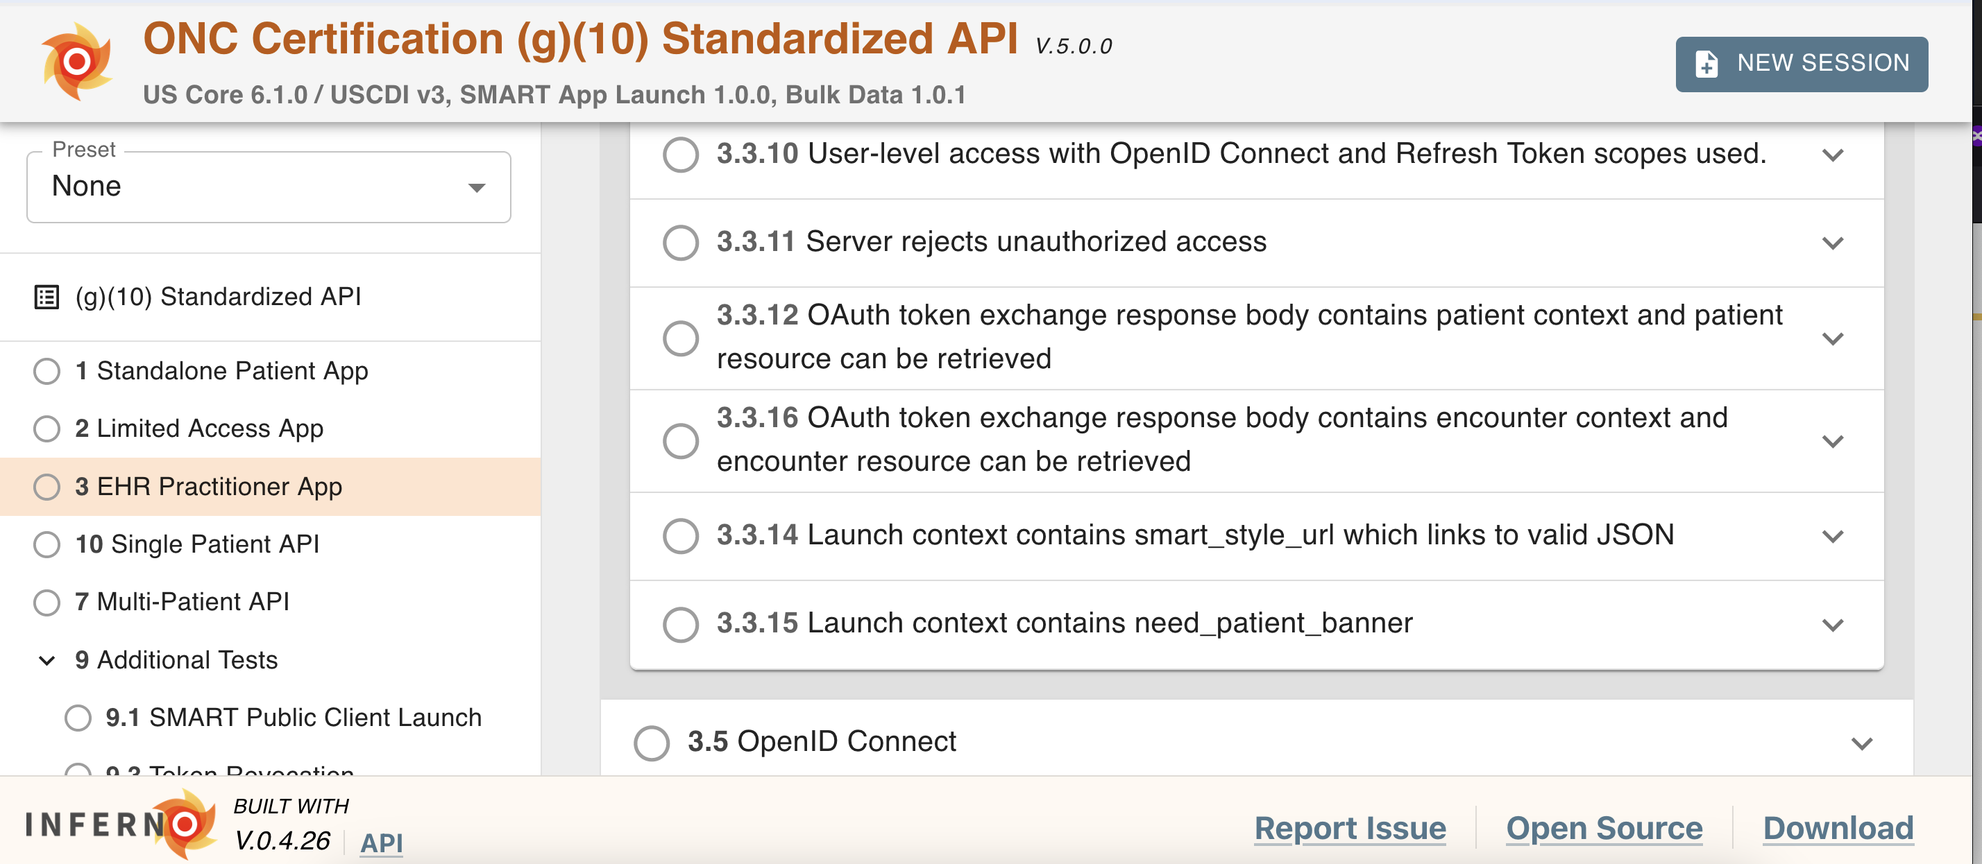
Changes that may result in new failures
Previous version incorrectly omitted a required check for SMART App EHR Launch Encounter context when using US Core v6.1.0
Added this check: it is the same as when users selected US Core 5

Slide 7
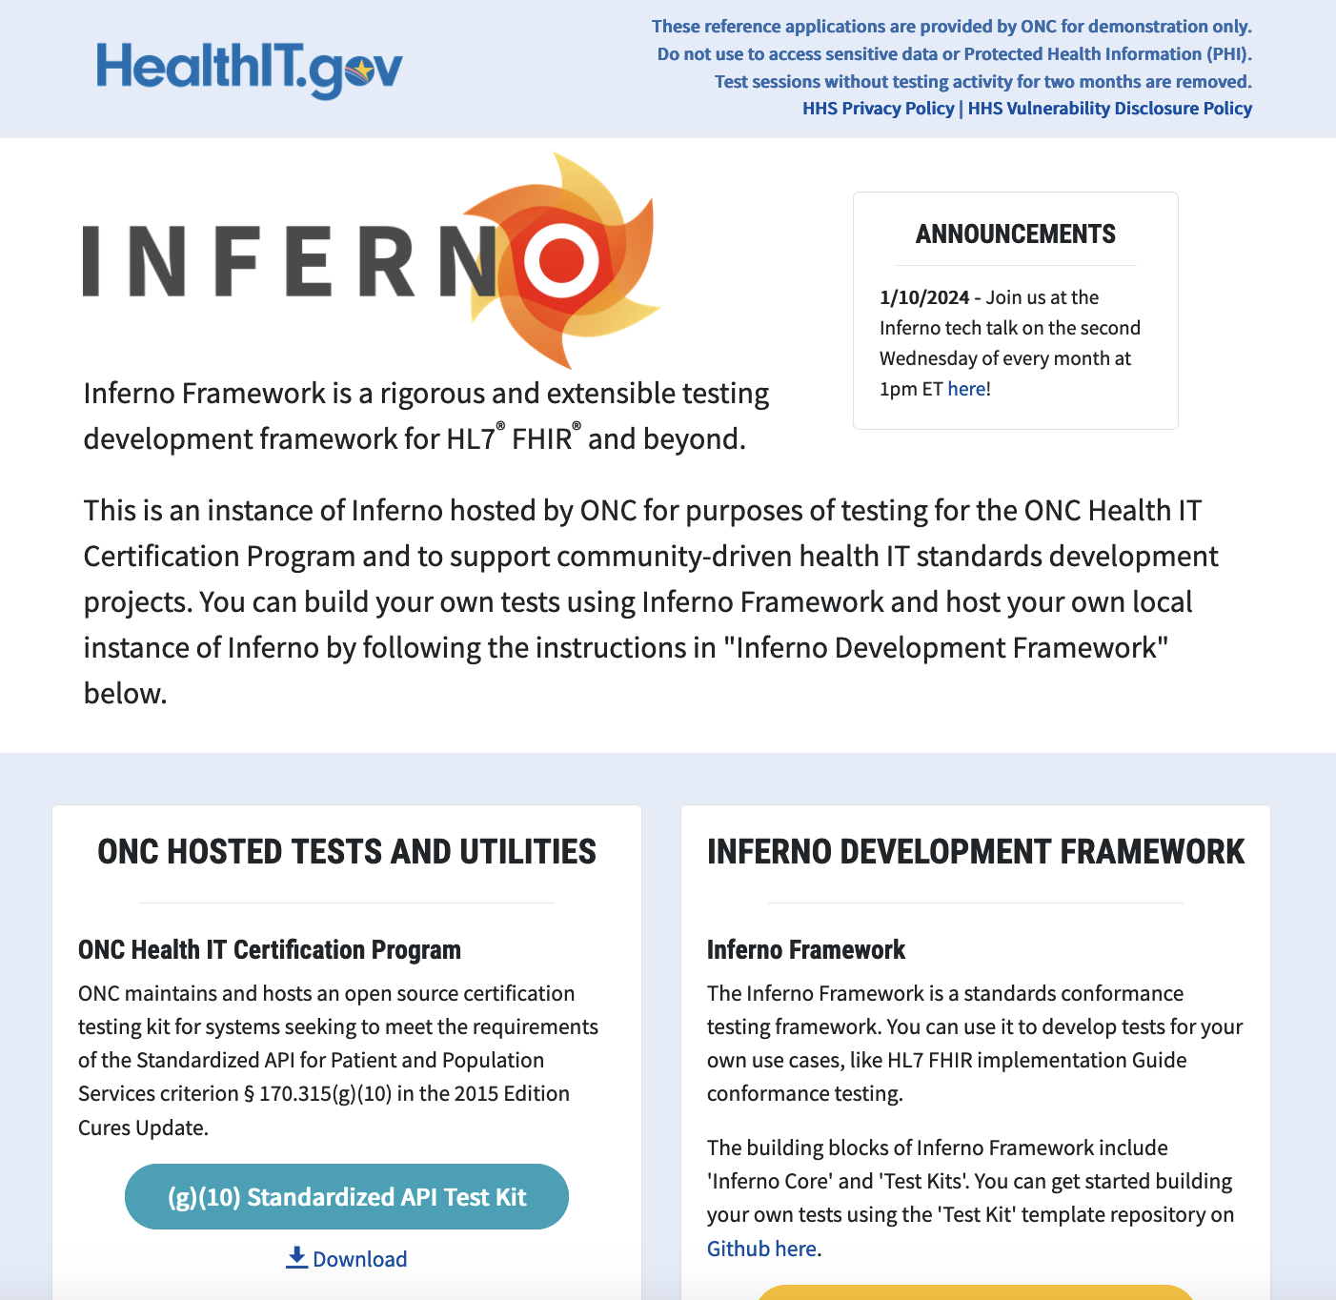
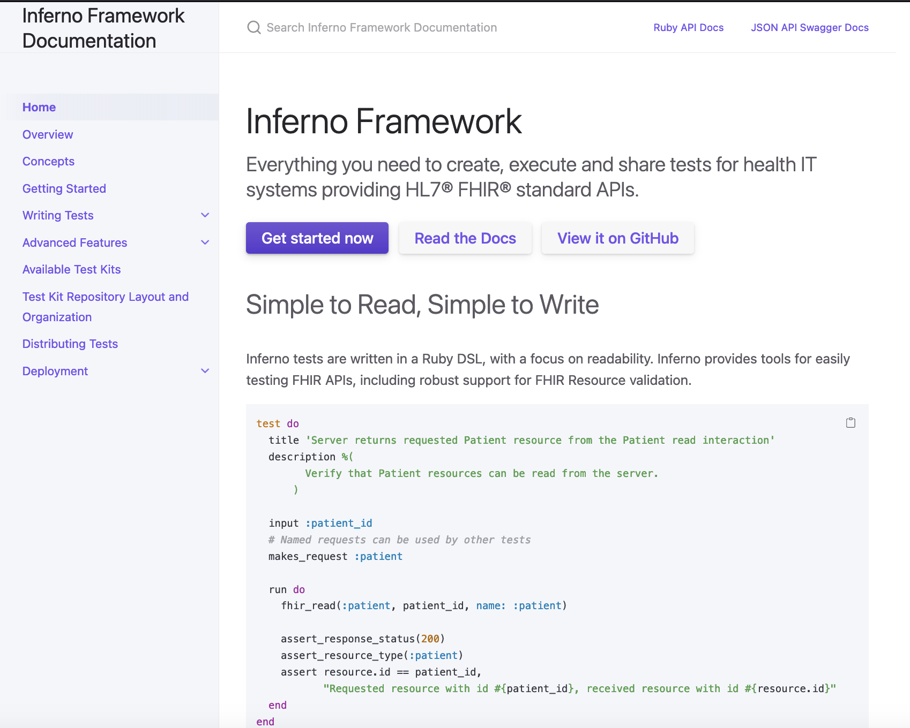
Inferno Redesign Preview
inferno.healthit.gov
inferno-framework.github.io
ONC-hosted testing for select Inferno tests
(e.g. (g)(10) Standardized API)
Inferno Documentation, including how to create your own tests

Slide 8
Redesign Goals
Improve design & visually refresh both sites
Better differentiate sites and their purposes
Expand content and consolidate information across multiple channels
Lay foundation for future content and improvements
Minimally disrupt existing workflows and users
Preview available today – Release Planned for February 13

Slide 9
Inferno on HealthIT.gov
Preview at https://inferno-qa.healthit.gov
ONC-Hosted Inferno Test Site

Slide 10
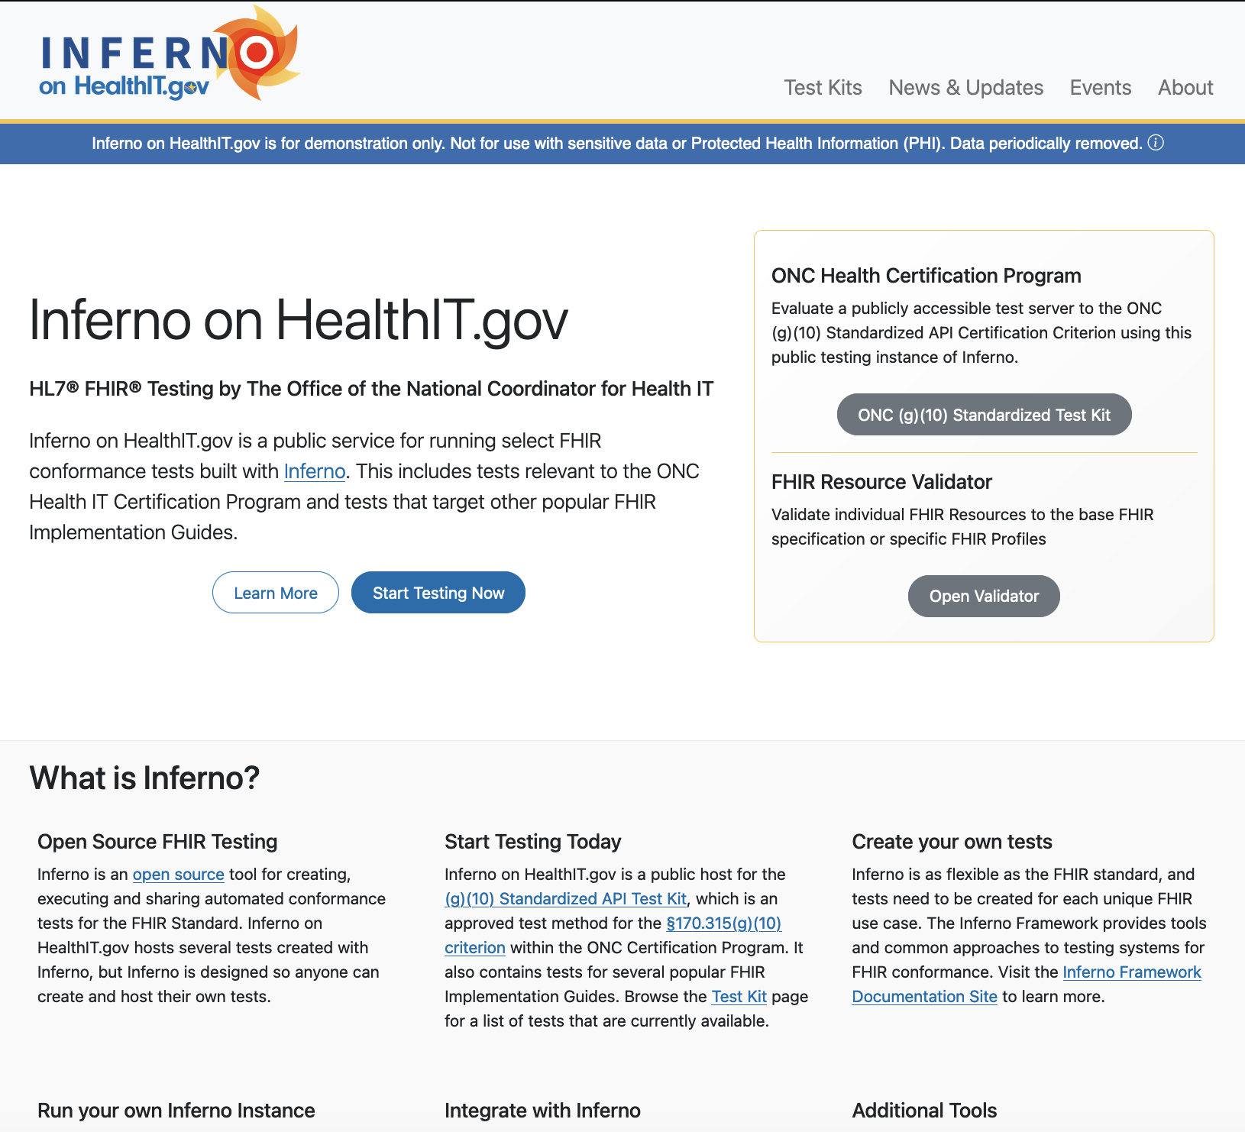
inferno.healthit.gov Redesign
Landing Page
Distinct branding for Inferno on HealthIT.gov
Important links to get started do not require scrolling
Explanatory “What is Inferno?” and News/Events below the fold
Preview at https://inferno-qa.healthit.gov

Slide 11
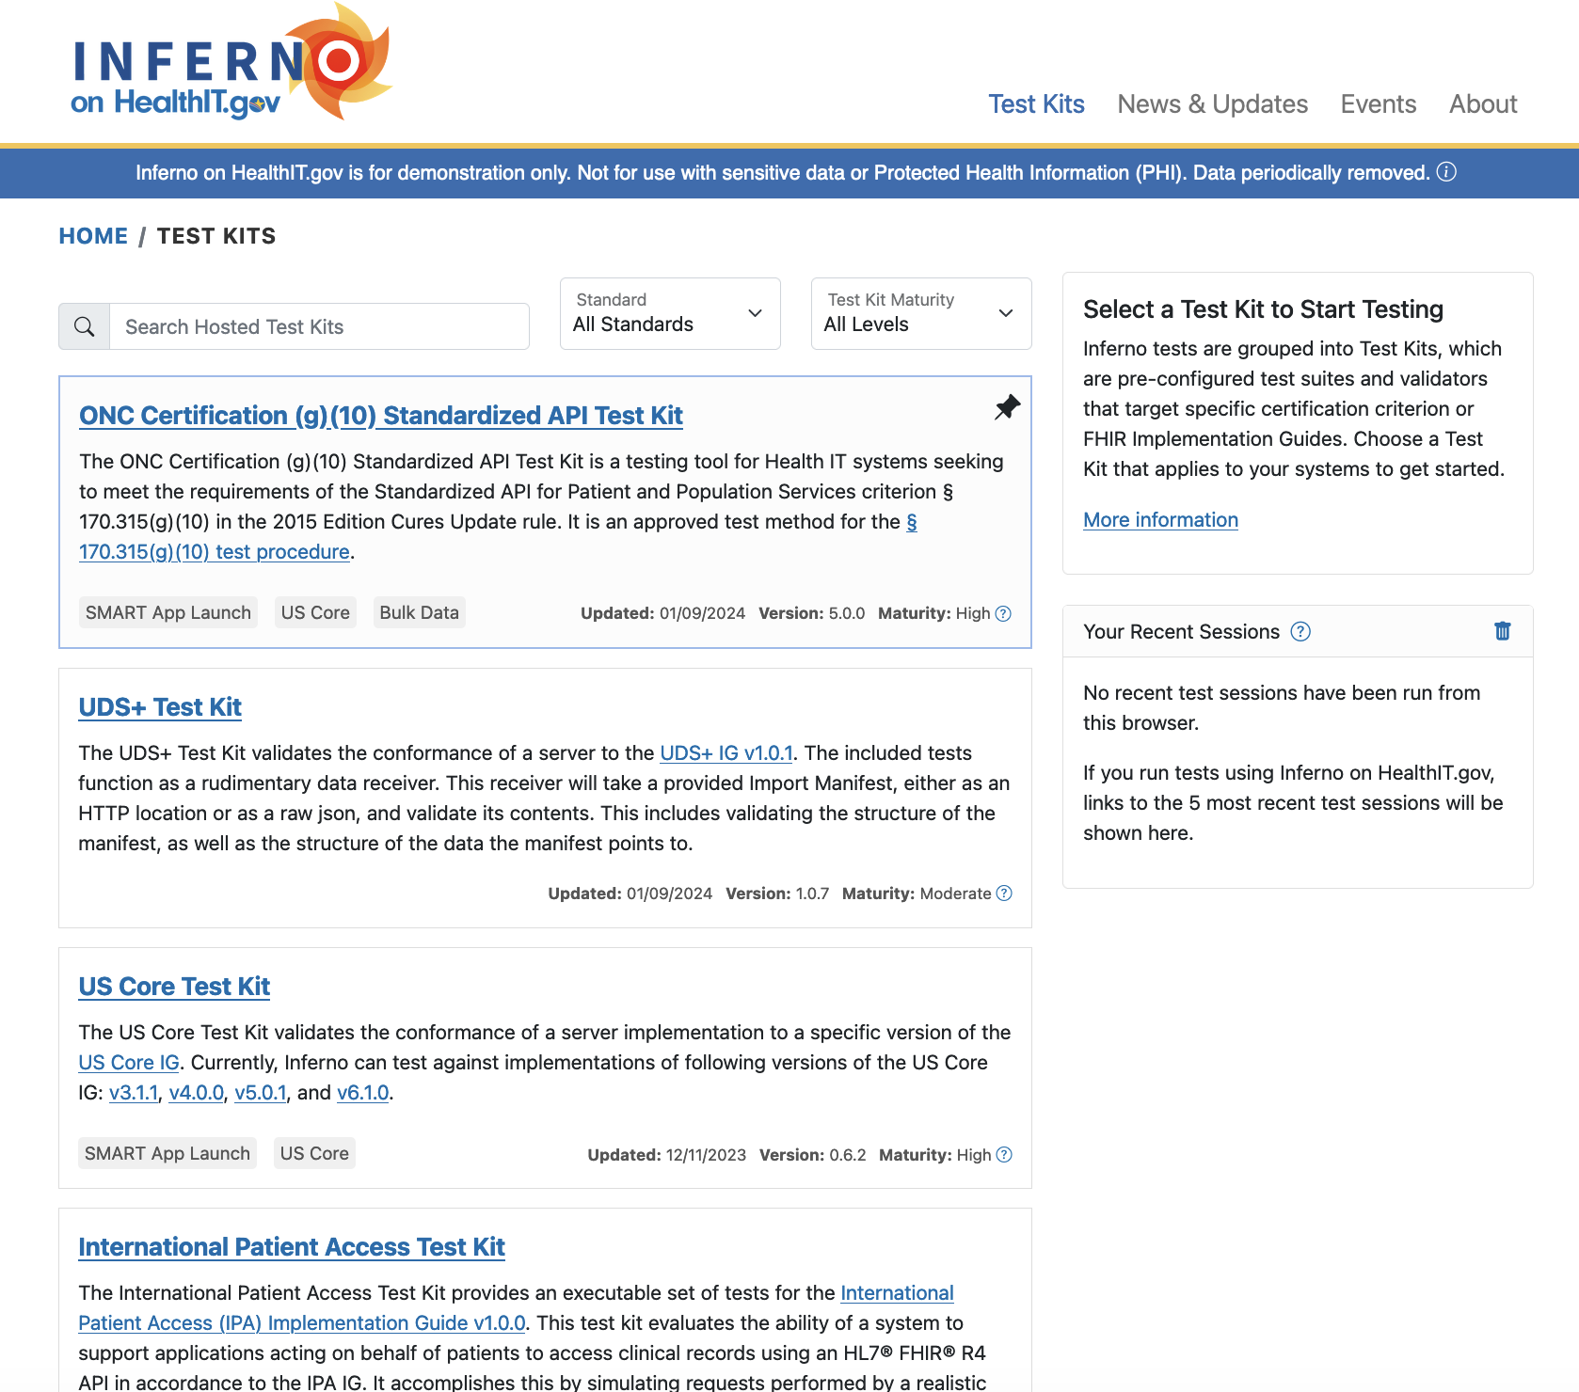
inferno.healthit.gov Redesign
Test Kit Listing Page
Tests are organized by Test Kits, which aligns with fundamental Inferno packaging strategy
Description, Last Updated and other metadata provided
Search/Filter added to accommodate growing list of test kits available on this host
”Your Recent Sessions”
Preview at https://inferno-qa.healthit.gov

Slide 12
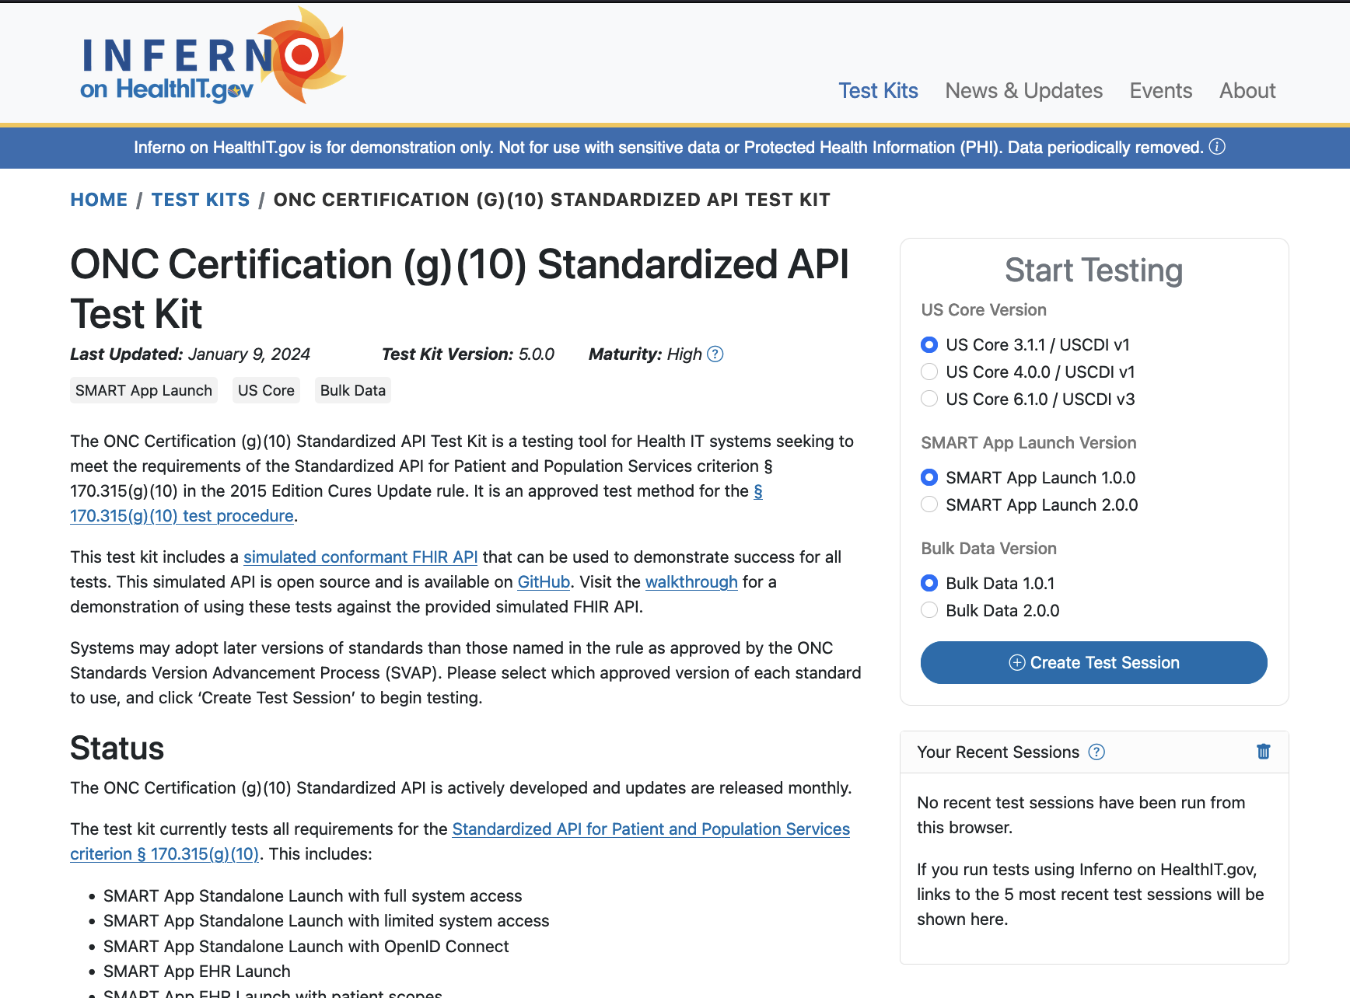
inferno.healthit.gov Redesign
Test Kit Page
New view with overview of the Test Kit and provides a permanent URL
Provides metadata such as version, maturity, last updated
Flexibility to provide extended content and links
Preview at https://inferno-qa.healthit.gov

Slide 13
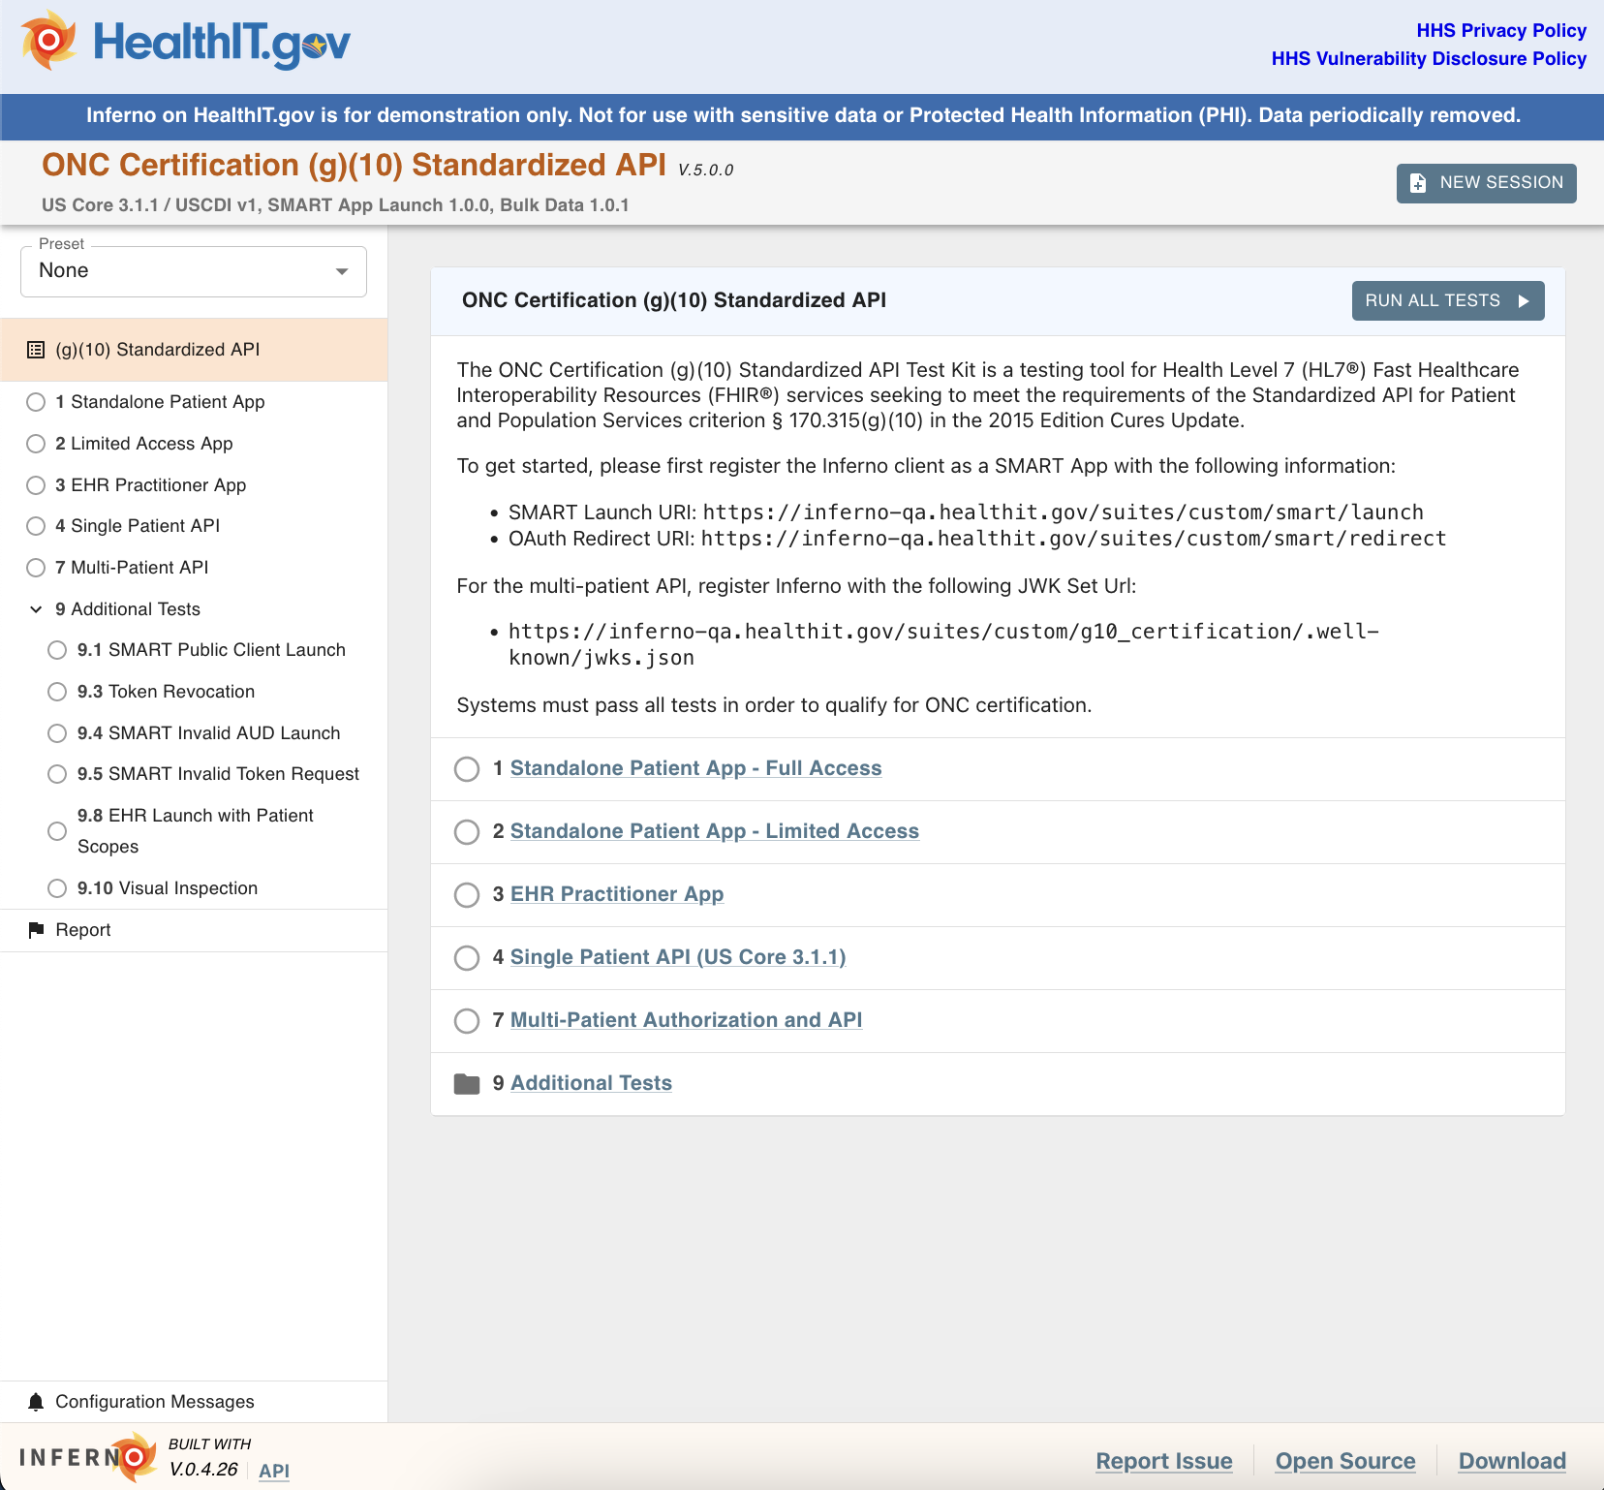
inferno.healthit.gov Redesign
Test Session Interface
No changes except for banner on top
URLs from previous release are unchanged and should still function
Preview at https://inferno-qa.healthit.gov

Slide 14
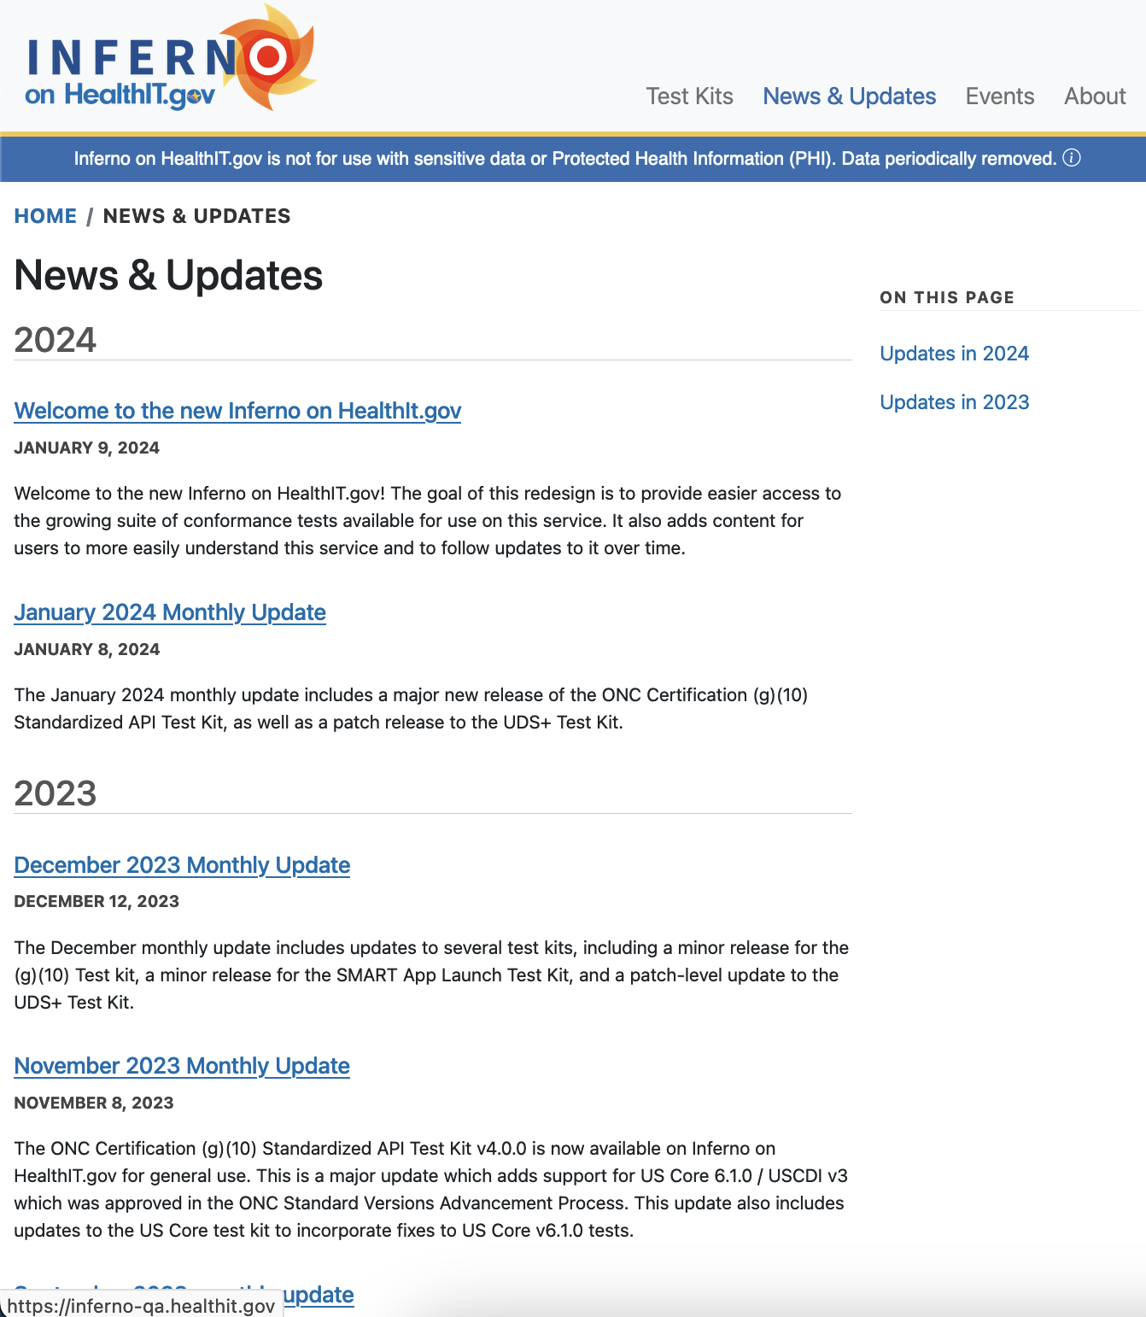
inferno.healthit.gov Redesign
News & Updates
Each deployment will have a news entry providing an overview of what has changed
Additional news will be provided as relevant
Preview at https://inferno-qa.healthit.gov

Slide 15
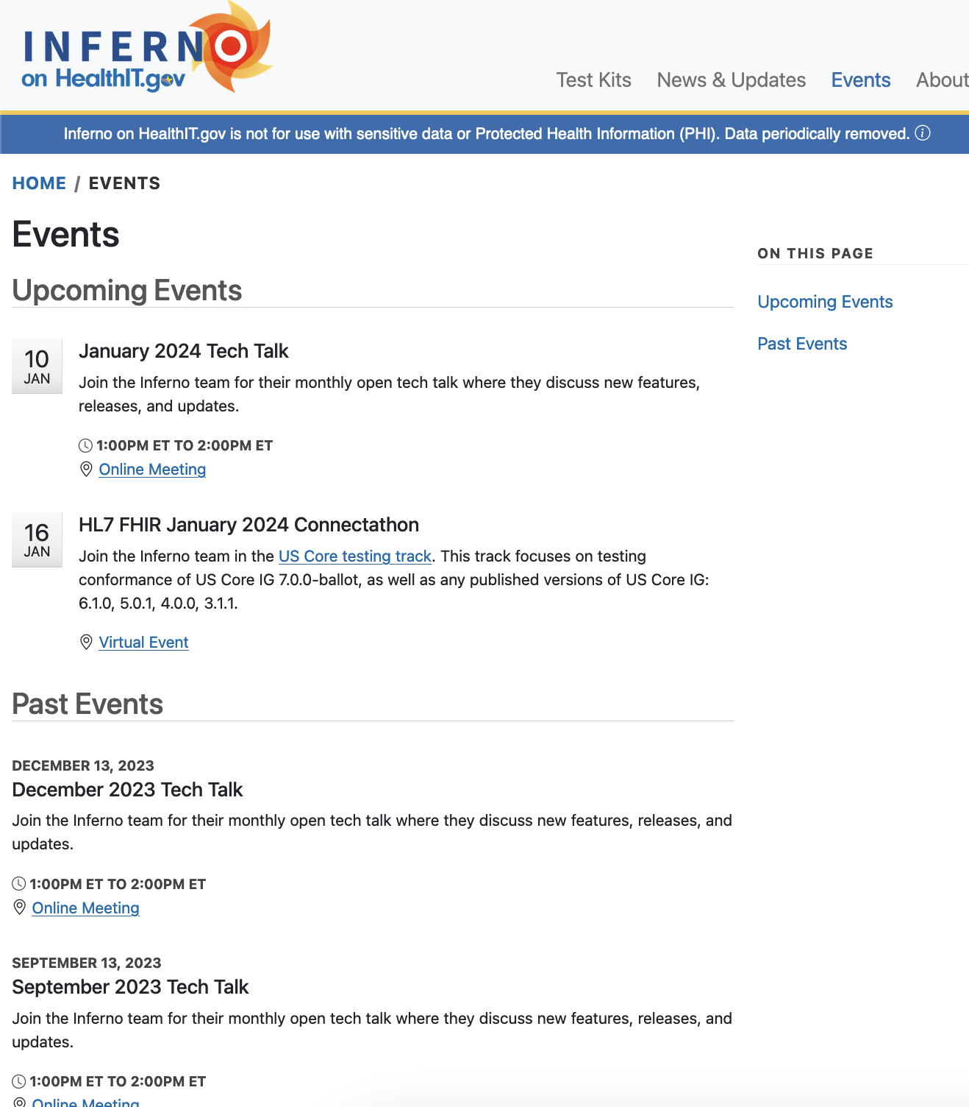
inferno.healthit.gov Redesign
Events
Provides information about upcoming events; such as Tech Talks & Test Event participation
Provides a history of events and relevant content
Preview at https://inferno-qa.healthit.gov

Slide 16
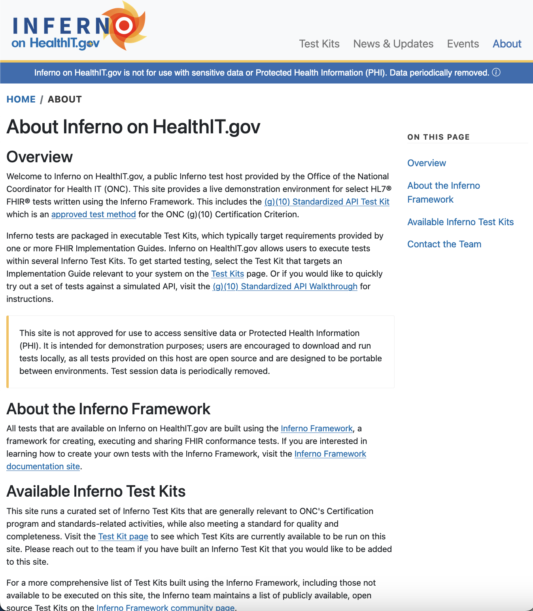
inferno.healthit.gov Redesign
About
Provides overview of Inferno on HealthIT.gov and the Inferno Framework
Preview at https://inferno-qa.healthit.gov

Slide 17
Inferno Framework Home
Preview at https://inferno-framework.github.io/index_new.html
Inferno Documentation and Community Hub

Slide 18
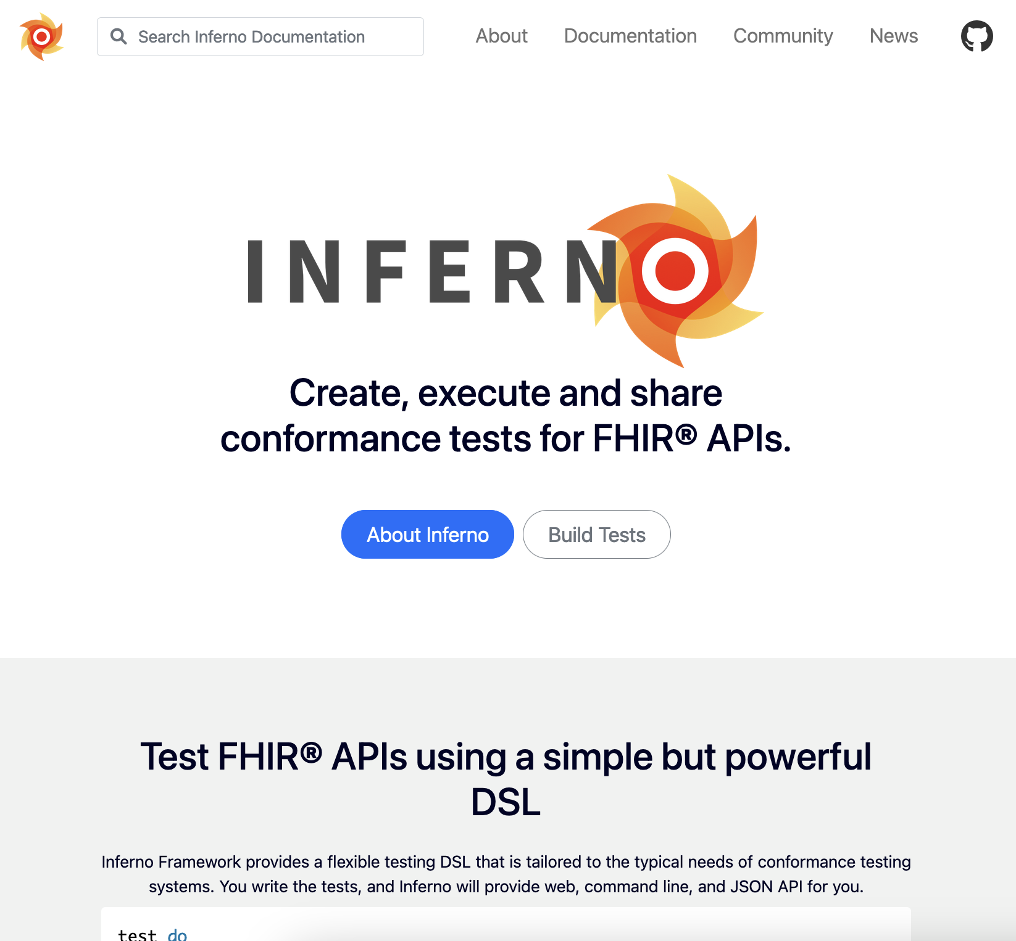
inferno-framework.github.io
Overview
Provides documentation on how to use Inferno to create and run tests; and how to participate in development
Not a host for executing tests
Preview at https://inferno-framework.github.io/index_new.html

Slide 19
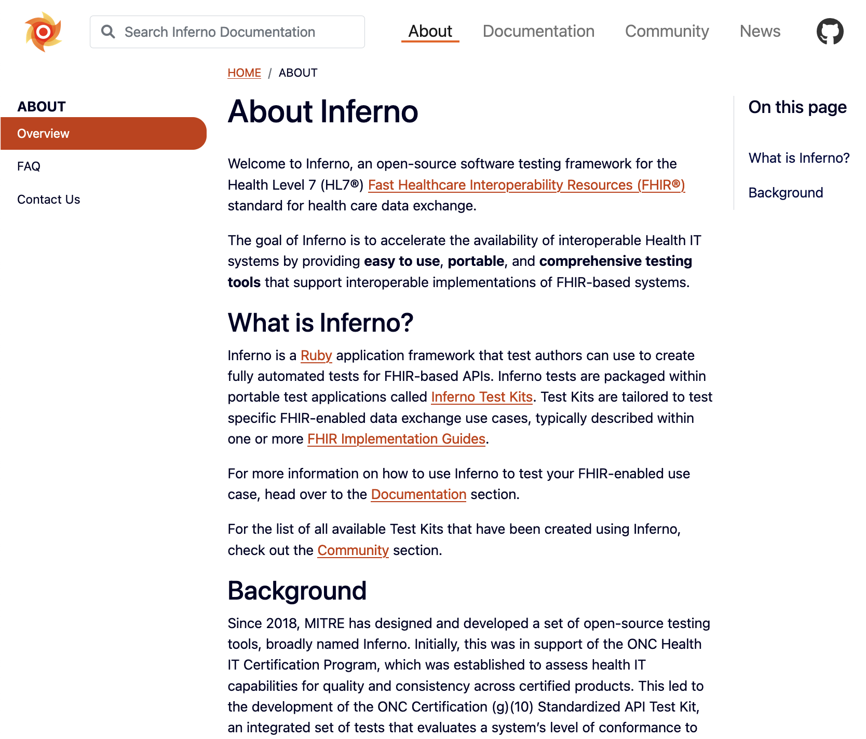
inferno-framework.github.io
About
Explanatory content for Inferno
Provides FAQ
Contact Information
Preview at https://inferno-framework.github.io/index_new.html

Slide 20
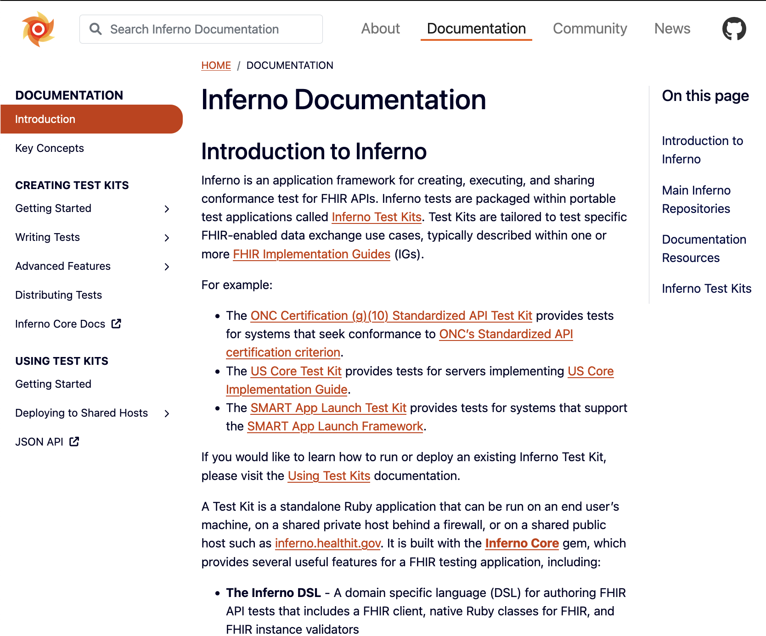
inferno-framework.github.io
Documentation
Approximately equivalent to what is currently on inferno-framework.github.io
Reorganized for clarity and some content added
Preview at https://inferno-framework.github.io/index_new.html

Slide 21
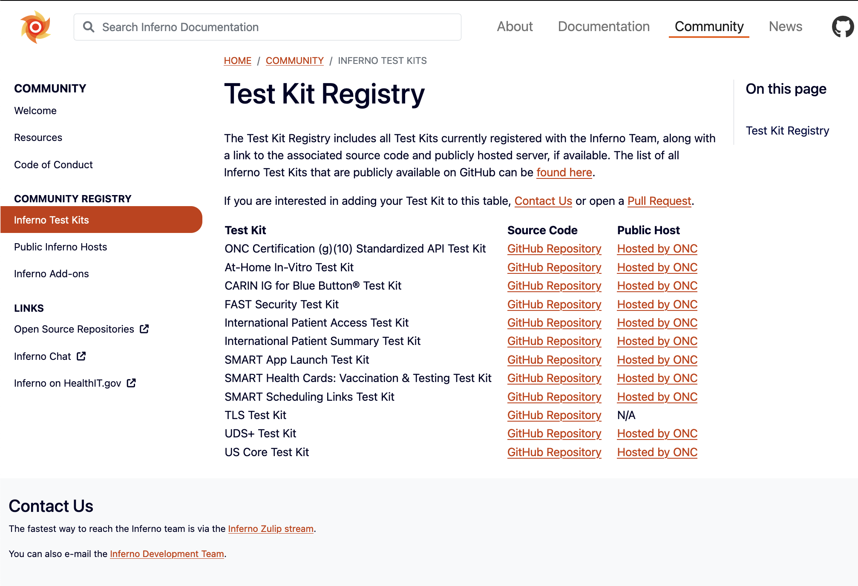
inferno-framework.github.io
Community
Describes how to contribute and participate in development of Inferno
Provides discoverability for Test Kits built with Inferno
Preview at https://inferno-framework.github.io/index_new.html

Slide 22
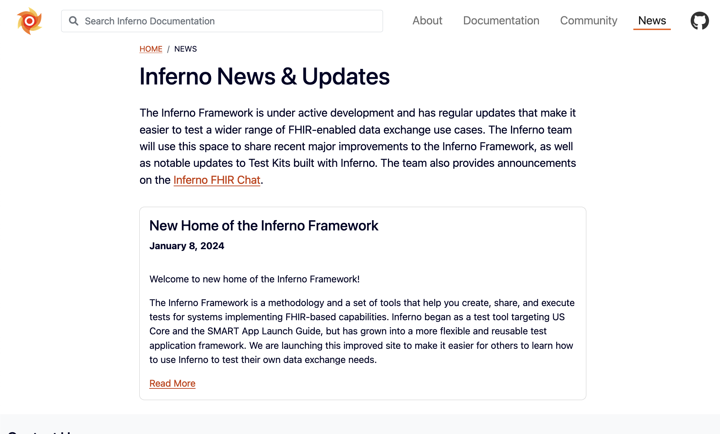
inferno-framework.github.io
News
Provides updates made to components of Inferno and foundational test kits
Preview at https://inferno-framework.github.io/index_new.html

Slide 23
Redesign: Feedback welcome!
https://inferno-qa.healthit.gov
https://inferno-framework.github.io/index_new.html
Expected to be deployed February 13
Redesign intended to be unintrusive
Please let us know if you have concerns

Slide 24
Open Discussion / Feedback

Slide 25
Resources and Contact Information
https://inferno.healthit.gov/
General materials & live demonstration server
https://github.com/onc-healthit/onc-certification-g10-test-kit/
ONC Certification tests repository, downloads, issues
“Watch” repository to receive alerts (new releases, etc)
Note: this repository is specific to ONC Certification testing
https://groups.google.com/forum/#!forum/inferno-testing
Announcements & community discussion
inferno@groups.mitre.org (or rscanlon@mitre.org)
Also, FHIR Zulip Chat: https://chat.fhir.org/#narrow/stream/179309-inferno

Slide 26
Upcoming Meetings
Next Inferno Tech Talk: Wednesday February 14 at 1 PM ET
Please reach out with questions & issues

